Slide 1
Capturing Reference Solutions
Guidelines for Digital Explorer | Solutions

Slide 2
Overview
Digital Explorer is a powerful knowledge repository capturing industry and technology trends as well as DXC delivered solutions. Building relationships between these two information sources provides a powerful capability for all our teams (consultancy, sales, accounts and marketing).
Digital Explorer | Solutions allows Demos, Concepts, Offerings, reference architectures and client solutions to be documented, shared and discovered through the platform.
Fact : Our client outcomes are driven by industry disruption
Fact : Technology becomes an ever increasing enabler across all business outcomes
Digital Explorer allows us to show these connections within our client conversations!
Realtime with innovation agendas
Industry trend discussions
Showcase solutions via Digital Explorer | Stories

Slide 3
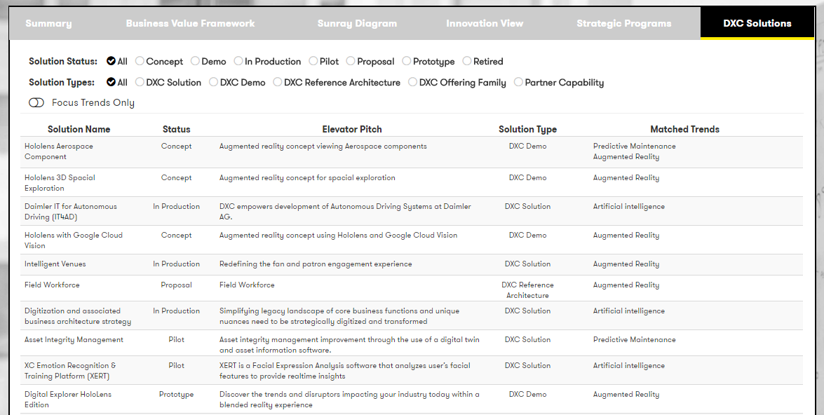
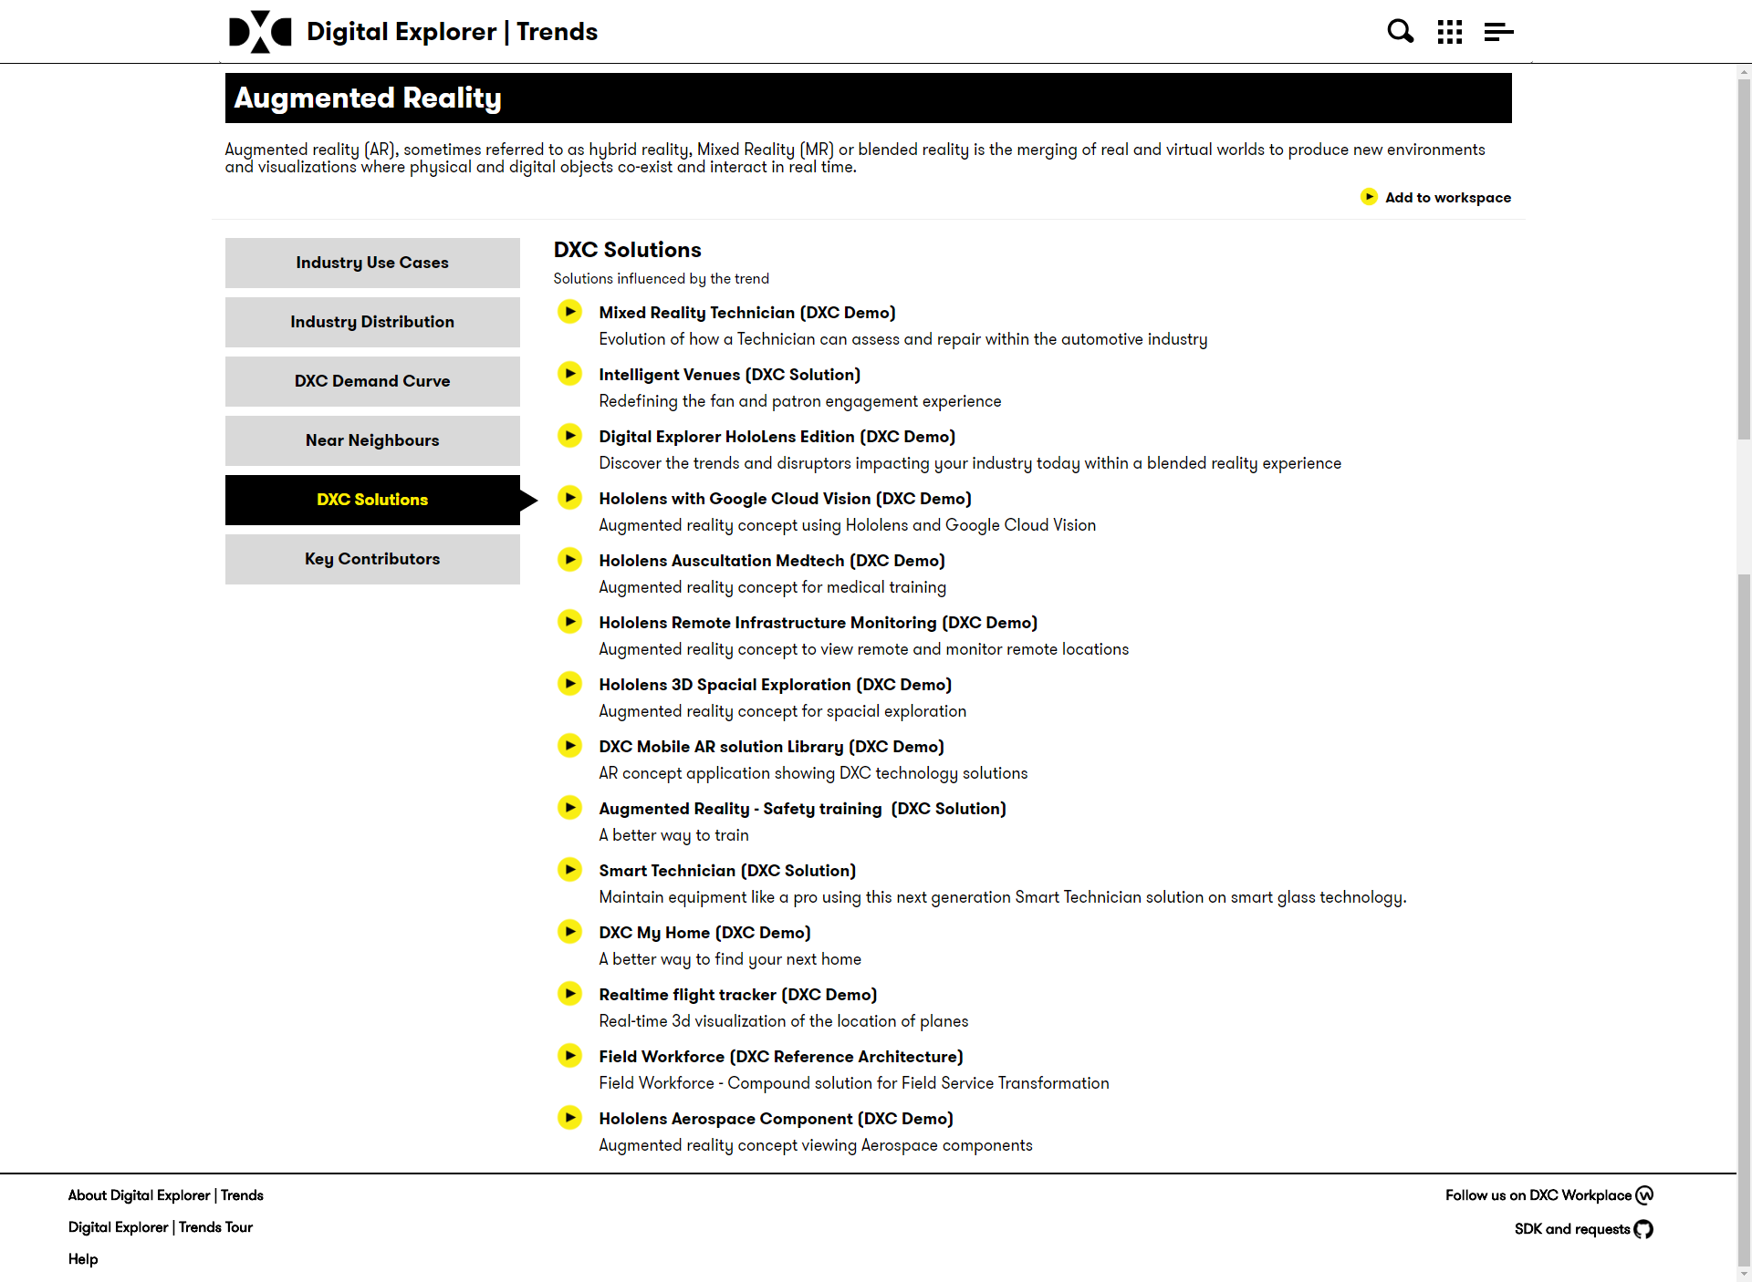
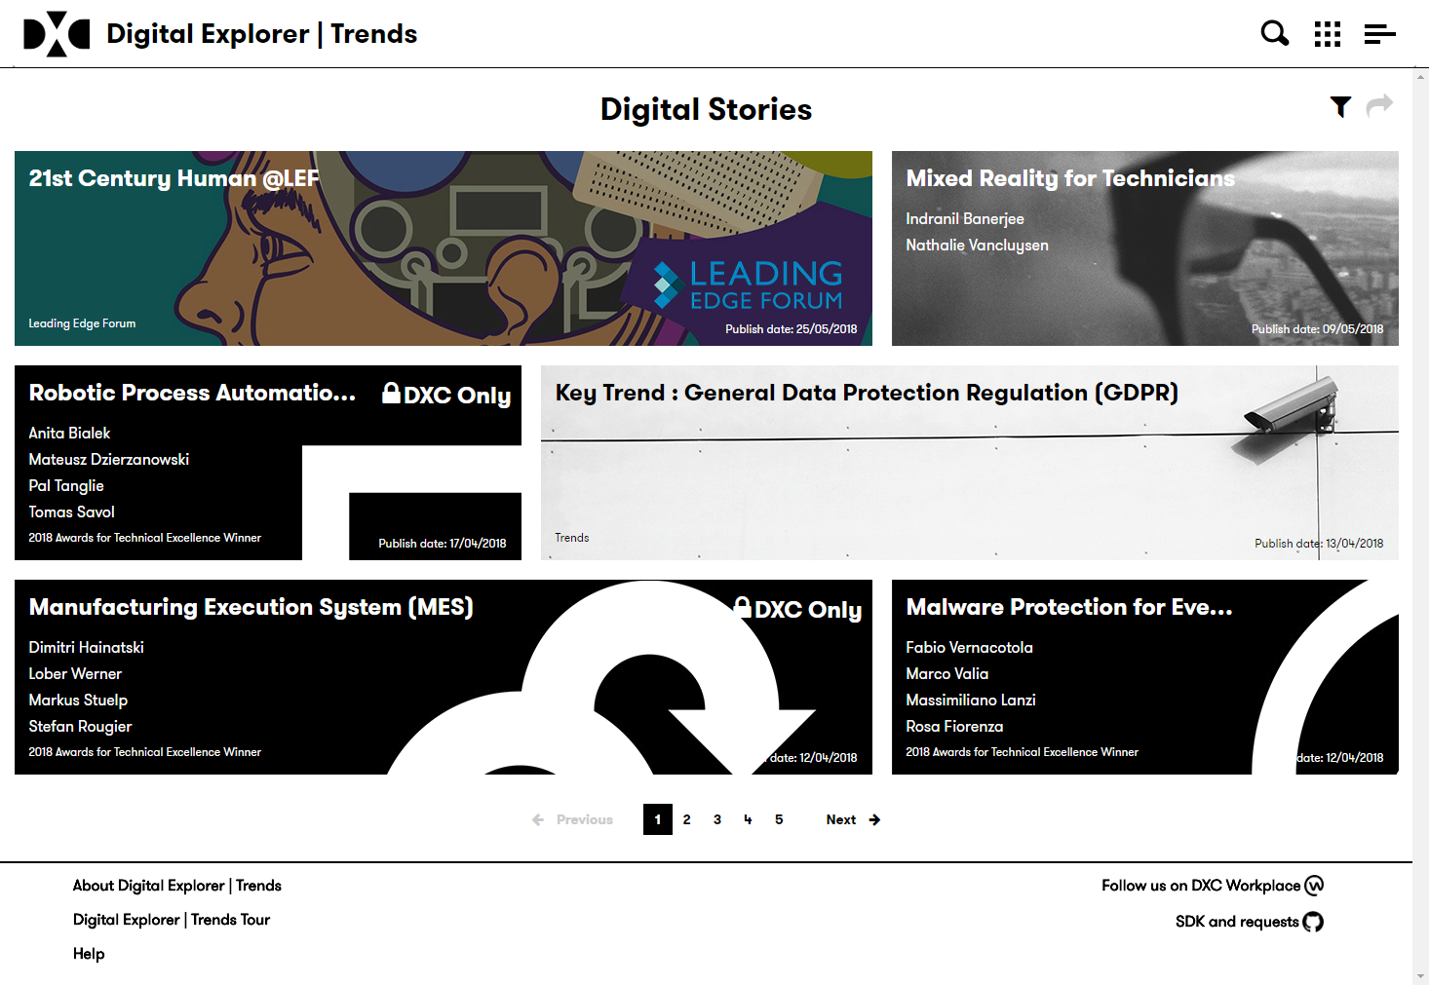
Where are solutions called out within the platform?
Real-time views within Innovation conversations
Detailed within Trend pages include all DXC solutions for you and clients to discover
Option to showcase within Digital Explorer Stories

Slide 4
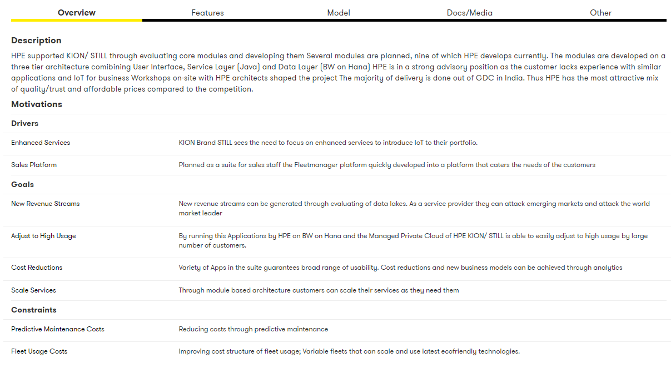
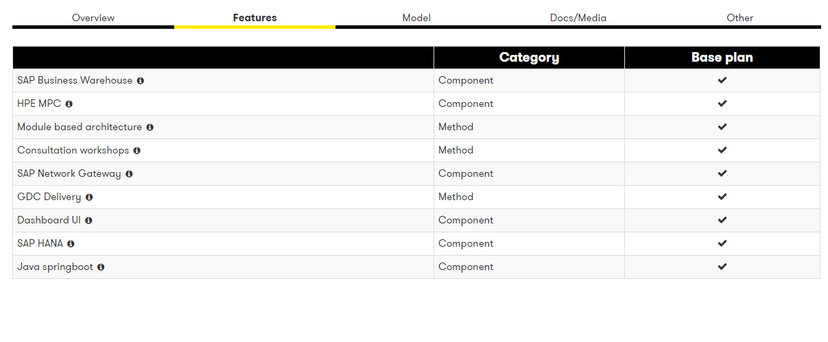
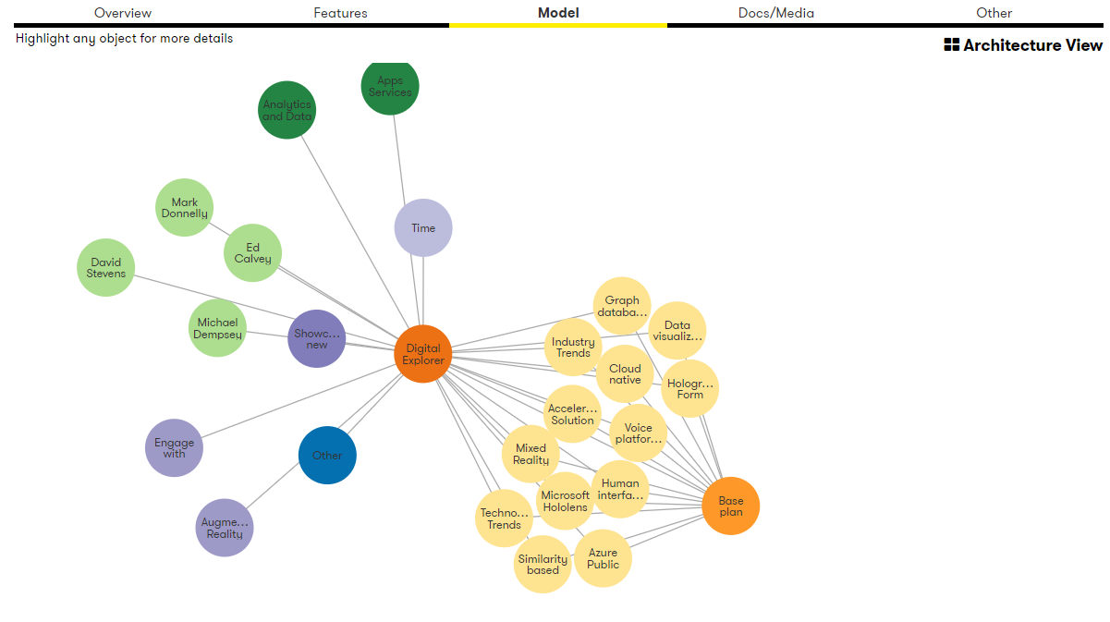
Solution Explorer
Solution Explorer is a dedicated module within the Digital Explorer Platform to capture and share our client outcomes.
You can describe each solutions using a simple, yet powerful model.
Business motivations
Solution features
Supporting media
You can reference existing features within your solutions
DXC offerings
Partner capabilities

Slide 5
Getting ready to submit your solution
Solution Type
Concept
Business Motivations
Business Trends
Features
DXC Offerings
Prototype
Pilot
Scale
Technology Trends
Client Goals
Partner Capabilities
Methods
Client Capabilities
Media
Images
Video
Links
Documents
Team
Architects
Developers
Testers
UX Designers
Reference Architecture

Slide 6
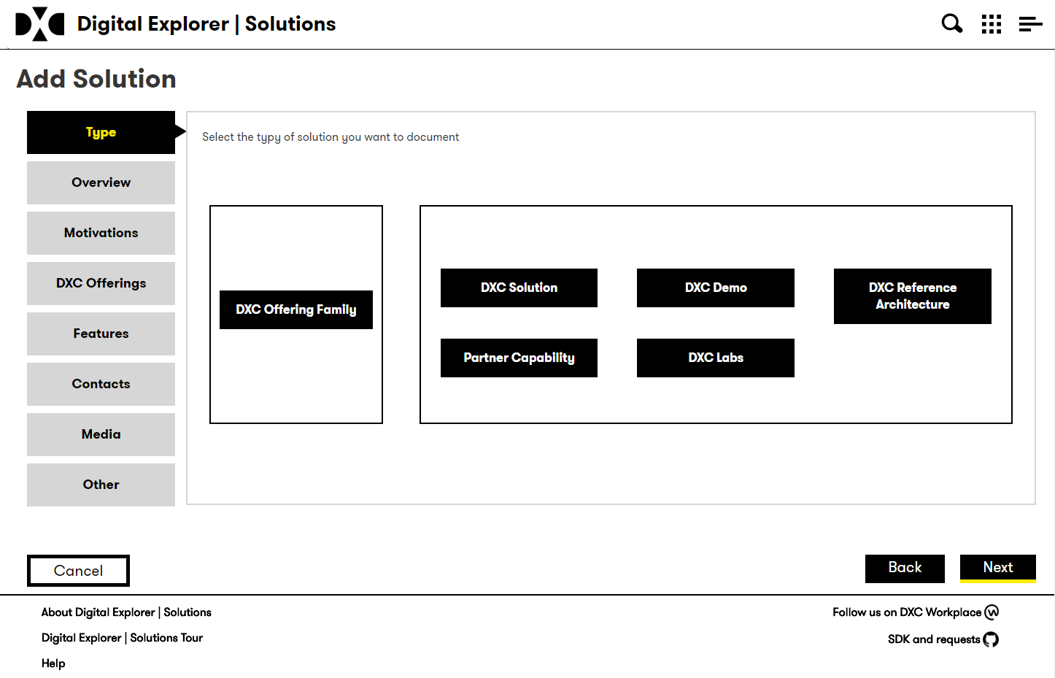
Types of Solution
Digital Explorer | Solutions supports many different types of Solutions, you can add demos, concepts, production solutions and even reference architectures.
Don’t be limited to only production solutions
Demos and concepts presented to clients are also valuable assets.

Slide 7
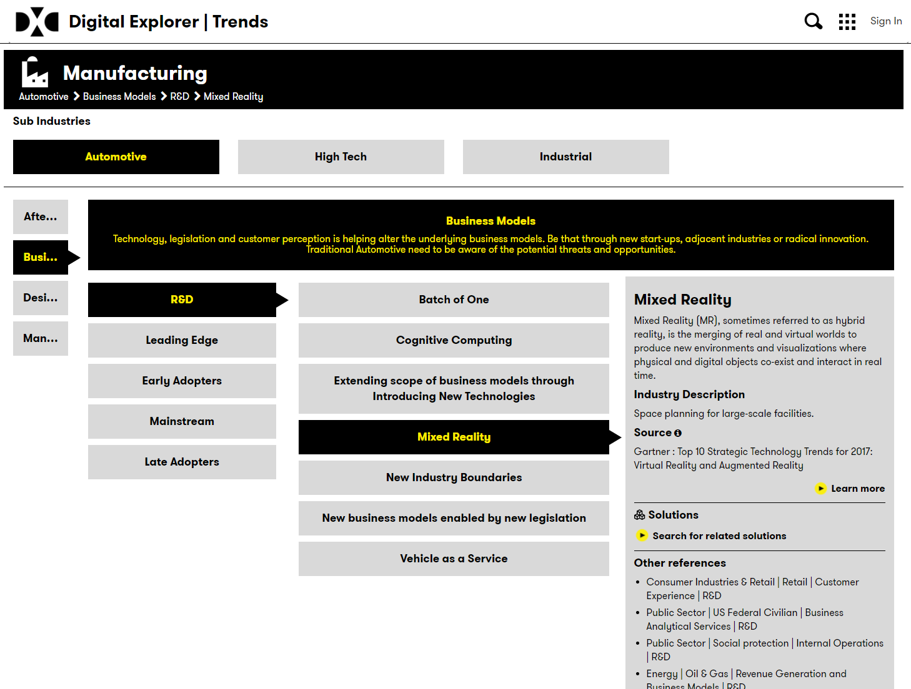
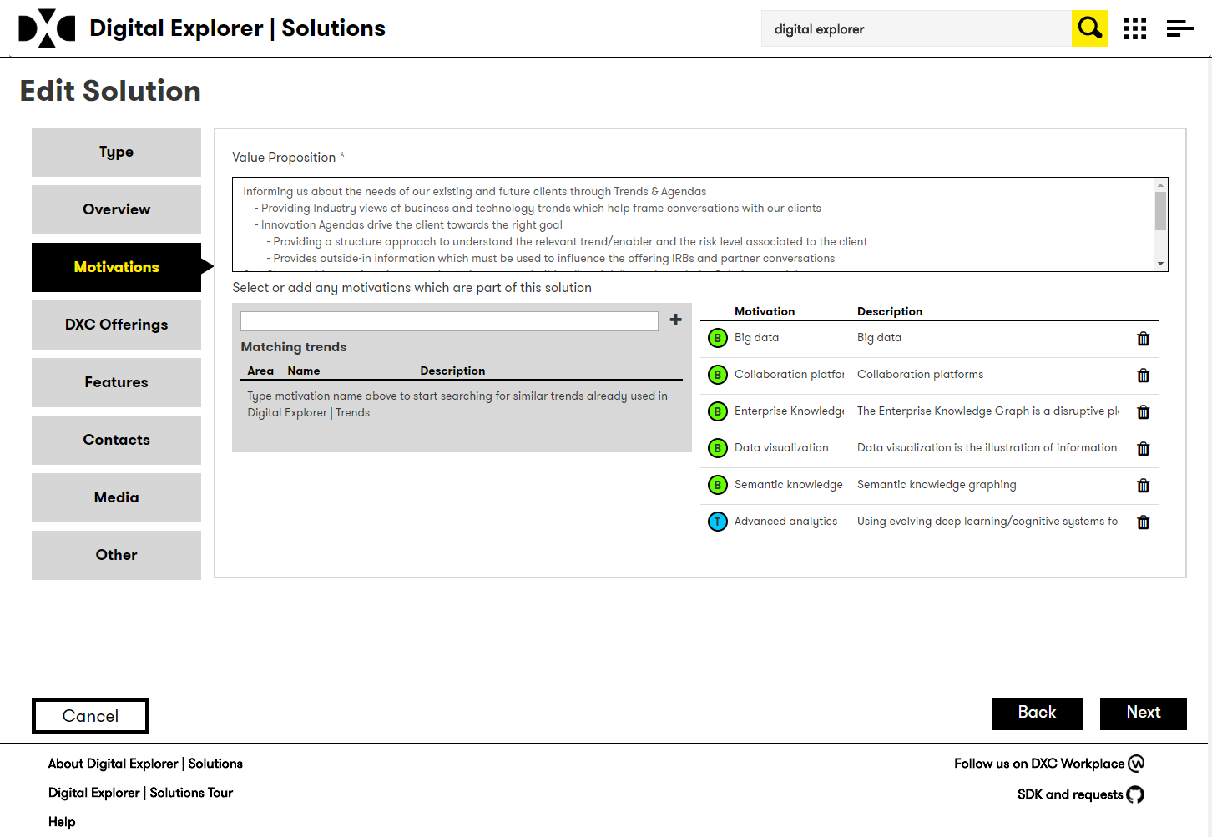
Business motivations
digitalexplorer.dxc.com
Focus on the industry disruption
Digital Explorer provides you with a rich set of industry trends to review and include within your solution definitions.
The more you match, the more threads we can connect.
Did you know: Account CT’s use the trends in their Client Innovation Agendas? Showing Concept, Prototype and Production examples as part of these direct client engagements showcases the full potential of DXC.

Slide 8
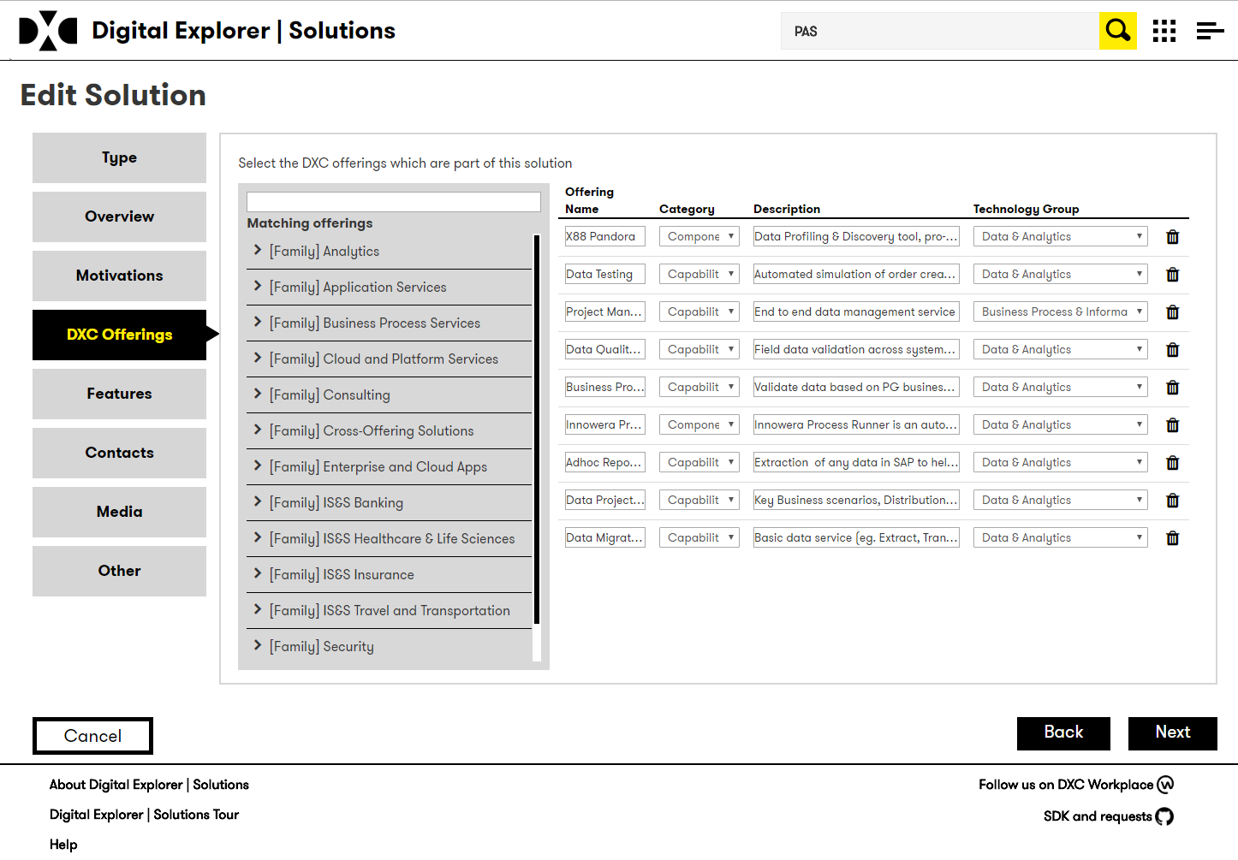
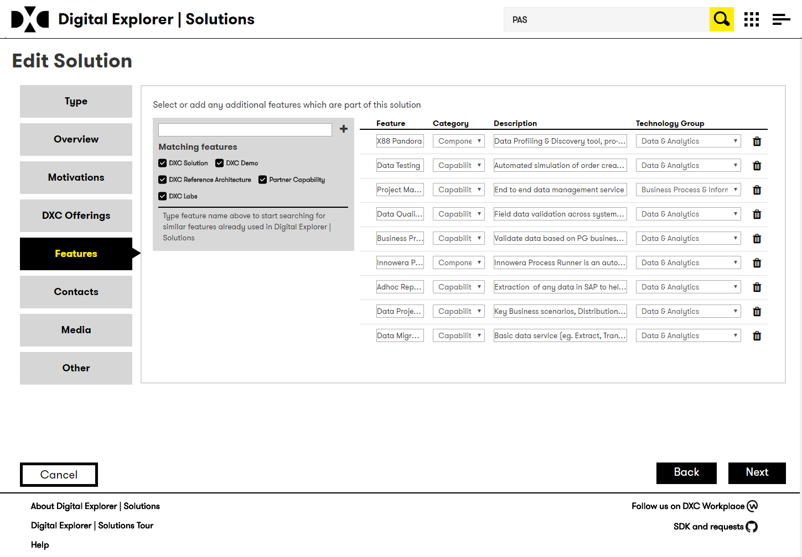
DXC offerings and features
1
Features provide the means to capture our DXC offerings, partners capabilities and methodologies applied to realize the client’s outcome.
You can select the DXC offerings used within your solution
You can add or select any existing features from existing solutions.
2

Slide 9
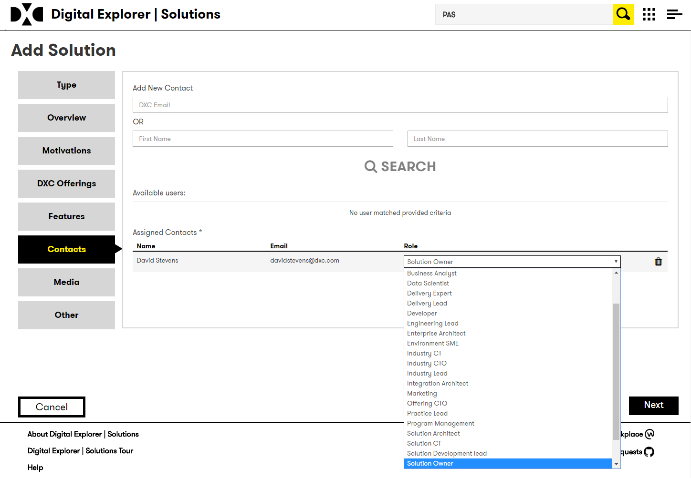
Team Members
Who was key to the design and development of this solution?
Architect
UX lead
Developer
Integration lead
Industry consultant
Solution, Account, Industry CT

Slide 10
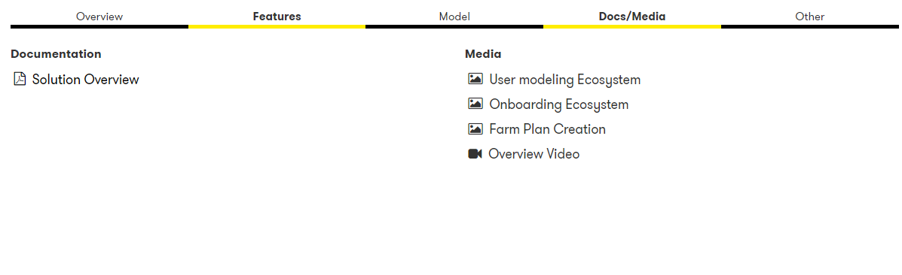
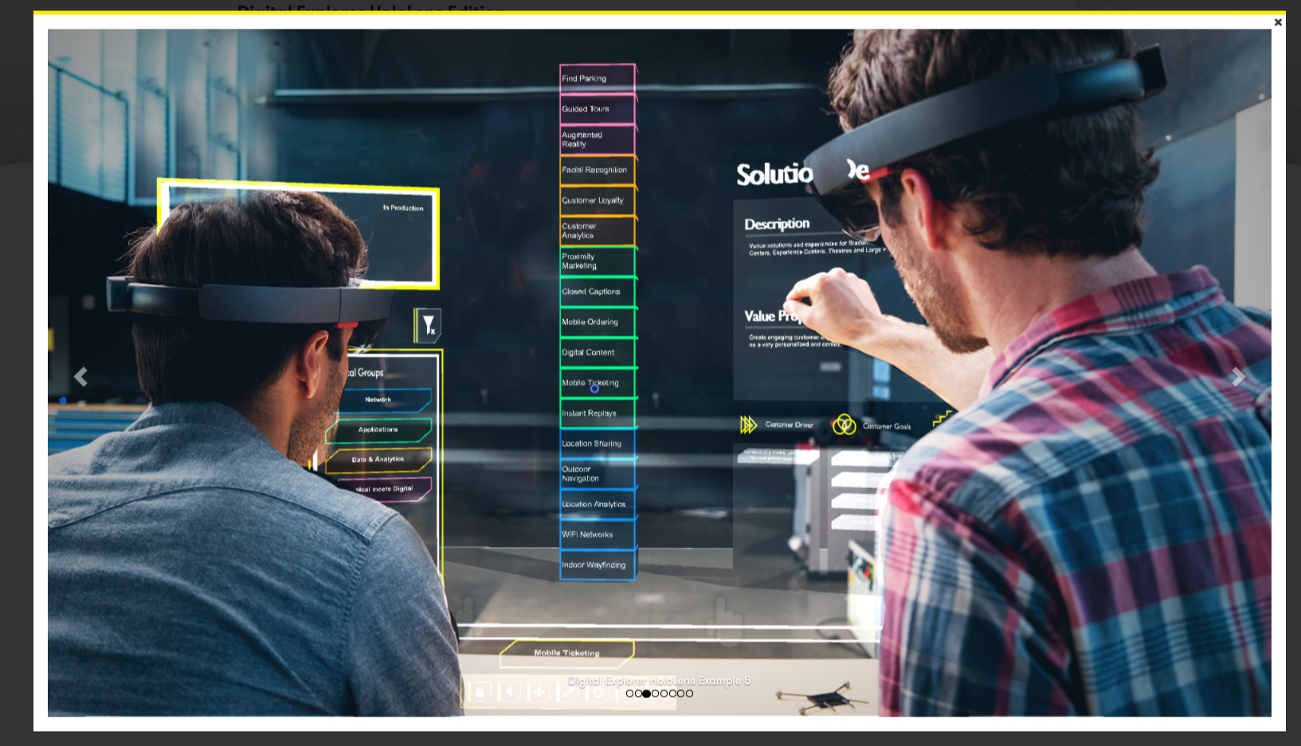
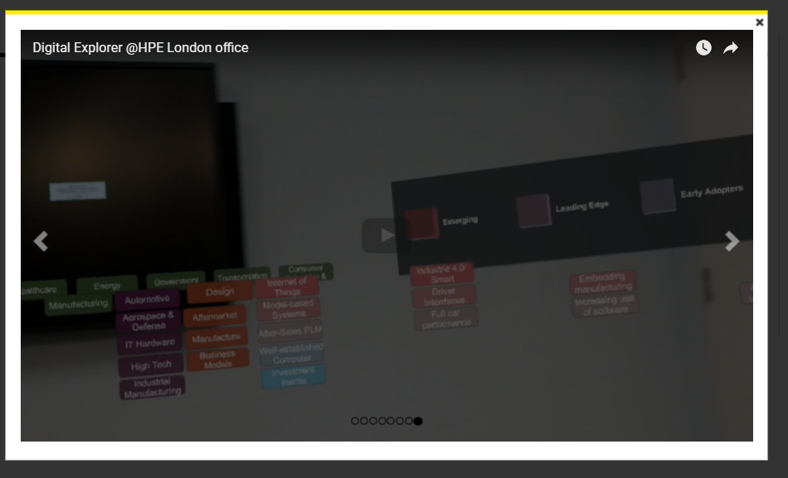
Supporting content
Digital Explorer | Solution supports many options for supporting content.
Documents
Images
Videos
External links
SharePoint
GitHub

Slide 11
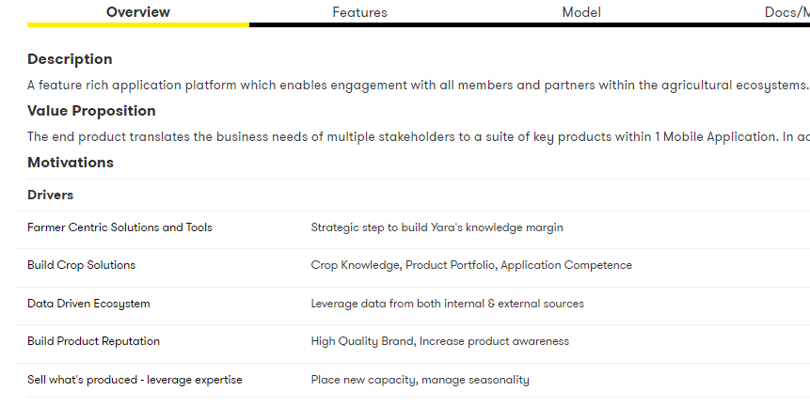
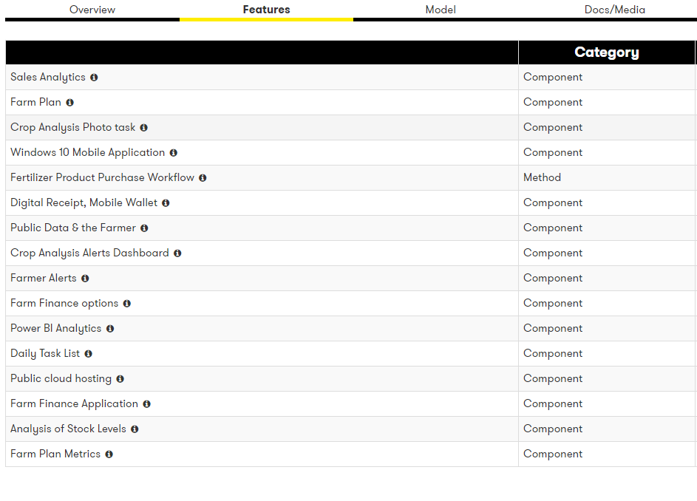
Example Solutions
Digital Explorer HoloLens Edition
Still Fleet management
Digital Agriculture Ecosystem platform
All these include
Matching trends
Emerging methodologies included in the feature list
Rich media content

Slide 12
Template

Slide 13
Solution capture form Page 1
Please attach any supporting media, videos, docs, images (files or links)
Name * |  | Status | Demo/Concept/Prototype/Pilot/Production**
Elevator Pitch * how would you tweet about your solution? Max 140 characters
Description * Max 5000 characters
Value Proposition * Max 5000 characters
Type * | DXC Offering Family/ DXC Reference Architecture / Partner Solutions/ DXC Client Solution*
* Required
** Delete as appropriate

Slide 14
Solution capture form Page 2 - Motivations
Please attach any supporting media, videos, docs, images (files or links)
General Business Motivations
Business Motivation | Description
Related Industry Trends https://digitalexplorer.dxc.com/de/
Trend | Trend | Trend | Trend | Trend

Slide 15
Please attach any supporting media, videos, docs, images (files or links)
Solution capture form Page 3 – Features *
Key Capabilities | DXC offerings | Partners and 3rd party capabilities | Methods
Examples… Event Handling Voice recognition | Examples… Enterprise Mobility Services Brokerage Services | Examples… Redhat openshift Microsoft Azure hosting | Examples… Agile
Industry | Referenceable | Account Name(s)
If all please enter “Pan-industry” | Yes/No
* Must have at least one feature

Slide 16
Please attach any supporting media, videos, docs, images (files or links)
Solution capture form Page 4 *
Contact Name | Contact Email | Role
 |  | Examples: Solution Owner Architect UX Lead Tester
* Must have at least one person assigned

Slide 17
Thank you
For more details please contact David Stevens (davidstevens@dxc.com)

